Slide 1
Python Programming
Session 1: (Data Structures, Control Flow, and Loops)

Slide 2
Agenda:
1 | Data Containers
2 | Control Flow
3 | For Loops and While Loops
4 | Practical Application

Slide 3
Data Containers

Slide 4

Data Containers
Python provides several built-in data structures (or containers) to organize and manage data efficiently. These include lists, tuples, sets, and dictionaries.
Lists
A list is an ordered, mutable collection of items. Lists can contain items of different types, including other lists.
Syntax
Lists are defined using square brackets [ ]
Key Characteristics of list
Ordered: Lists allow access to items using an index.
Mutable: You can add, delete, or modify items in a list.
Non-Unique Items: Lists can contain duplicate elements.
Mixed Data Types: Lists can hold items of different data types.

Slide 5


Data Containers
Lists Operations
Indexing
Access elements using their index (starting at 0)
Slicing
Access a range of elements

Slide 6

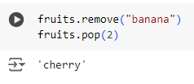
Data Containers
Lists Operations
Adding Elements
Use append() to add an item, insert() to add at a specific index.
Removing Elements
Use remove() to delete an item, pop() to remove by index.

Slide 7


Tuples
A tuple is an ordered, immutable collection of items. Once defined, its contents cannot be changed.
Syntax
Tuples are defined using parentheses ( )
Operations
Indexing and Slicing: Similar to lists.
Immutability
Cannot change elements, which makes tuples faster for read-only data.

Slide 8
Tuples
Key Characteristics of Tuples
Ordered: Tuples allow access to items using an index.
Immutable: You cannot add, delete, or modify items in a tuple.
Non-Unique Items: Tuples can contain duplicate elements.
Mixed Data Types: Tuples can hold items of different data types.

Slide 9

Sets
A set is an unordered collection of unique items. Sets are used for membership testing and eliminating duplicate entries.
Syntax
Sets are defined using curly braces {} or the set() function
Operations
Adding Elements: Use add()

Slide 10
Sets
Key Characteristics of Sets
Unordered: Sets do not maintain a specific order of items.
No Indexing/Slicing: Sets do not support indexing or slicing operations.
Immutable Data Types: Sets can only contain immutable data types (e.g., numbers, strings, tuples).
Unique Items: Sets automatically remove duplicate items, ensuring all elements are unique.

Slide 11

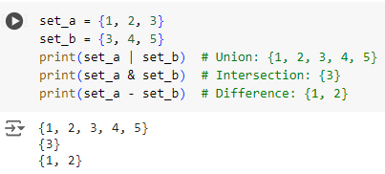
Sets
Operations
Removing Elements: Use remove() or discard()
Set Operations: Union, intersection, difference.

Slide 12


Dictionaries
A dictionary is an unordered collection of key-value pairs. Keys must be unique and immutable (e.g., strings, numbers).
Syntax
Defined using curly braces { } with key-value pairs separated by colons.
Operations
Accessing Values: Use keys.
Adding/Updating: Assign a value to a key.

Slide 13

Dictionaries
Operations
Removing Items: Use pop() to remove a key-value pair.
Key Characteristics of Dictionaries
Key-Value Pairs: Dictionaries store data as key-value pairs.
Immutable Keys: Dictionary keys must be immutable (e.g., numbers, strings, tuples).
Flexible Values: Dictionary values can be of any data type.
Unique Keys: Each key in a dictionary must be unique.
Unordered: Dictionaries are not ordered; elements are accessed using keys.

Slide 14
Comparing Lists, Tuples, Sets, Dictionaries
List | Tuple | Set | Dictionary
[] or list() | () or tuple() | {} or set() | {} or dict()
Ordered | Ordered | Unordered | Unordered
Changeable | Unchangeable | Unchangeable | Changeable
Indexed | Indexed | Unindexed | Key Value pair
Allows Duplicates | Allows Duplicates | No Duplicates | No Duplicates
Allows Slicing | Allows Slicing | No Slicing | No Slicing

Slide 15
Control Flow

Slide 16
Control Flow
Control flow statements are essential in programming as they enable the execution of specific blocks of code based on conditions. This allows for dynamic decision-making within a program. In Python, the primary control flow statements include if, elif, and else. We'll cover these concepts with detailed explanations and multiple examples to illustrate their use.

Slide 17

Control Flow
If Statements
The if statement is used to test a specific condition. If the condition evaluates to True, the code block under the if statement is executed.
Syntax

Slide 18
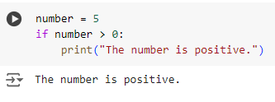
If Statements
Examples
Check Positive Number
This code checks if the number is greater than zero. Since 5 > 0 is true, it prints "The number is positive.

Slide 19
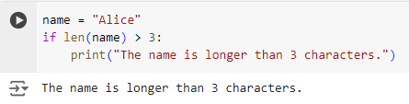
If Statements
Examples
Check String Length
The code checks if the length of the string name is greater than 3. Since "Alice" has 5 characters, the condition is true, and it prints "The name is longer than 3 characters."

Slide 20
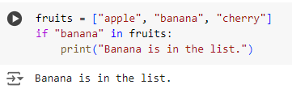
If Statements
Examples
Check Membership in List
The code checks if "banana" is an item in the fruits list. Since it is, the condition is true, and it prints "Banana is in the list."

Slide 21
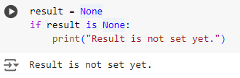
If Statements
Examples
Check if Variable is Not None
This code checks if result is None. Since it is, the condition is true, and it prints "Result is not set yet."

Slide 22
Control Flow
If-Else Statements
The if-else statement provides an alternative block of code that is executed if the condition is False.

Slide 23
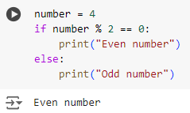
If-Else Statements
Examples
Check Even or Odd Number
This code checks if number is even by using the modulus operator %. Since 4 % 2 == 0 is true, it prints "Even number."

Slide 24
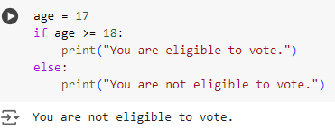
If-Else Statements
Examples
Age Verification
The code checks if age is 18 or older. Since age is 17, the condition is false, so it prints "You are not eligible to vote."

Slide 25
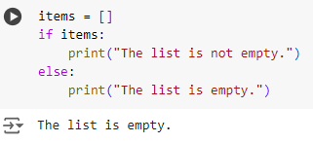
If-Else Statements
Examples
Check for Empty List
The code checks if items is a non-empty list. Since items is empty, the condition is false, and it prints "The list is empty."

Slide 26
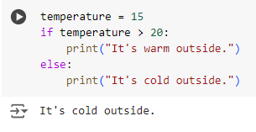
If-Else Statements
Examples
Temperature Check
This code checks if the temperature is greater than 20. Since 15 is not greater than 20, it prints "It's cold outside."

Slide 27
Control Flow
If-Elif-Else Statements
The if-elif-else statement allows checking multiple conditions sequentially. Only the block of the first True condition is executed. If none of the conditions are True, the else block is executed.

Slide 28
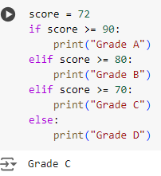
If-Elif-Else Statements
Examples
Grading System
This code assigns grades based on score. Since the score is 72, it matches the elif score >= 70: condition, so it prints "Grade C."

Slide 29
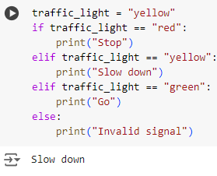
If-Elif-Else Statements
Examples
Traffic Light Signal
This code checks the color of traffic_light. Since it is "yellow," it matches the second condition and prints "Slow down."

Slide 30
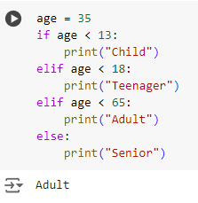
If-Elif-Else Statements
Examples
Classify Age Group
The code classifies age into different groups. Since 35 is less than 65 but more than 18, it matches the "Adult" category and prints "Adult."

Slide 31
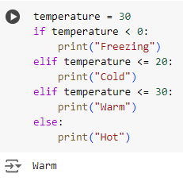
If-Elif-Else Statements
Examples
Check Temperature Range
The code checks which temperature range temperature falls into. Since it is 30, it matches the elif temperature <= 30: condition and prints "Warm."

Slide 32
Control Flow
Nested If Statements
If statements can be nested within other if statements to create complex conditions.

Slide 33
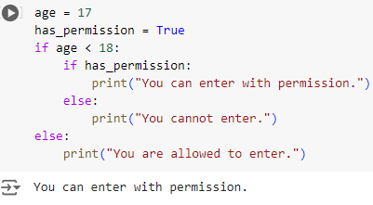
Nested If Statements
Examples
Permission Check with Age
This code checks if age is less than 18 and then checks if has_permission is True. Since both conditions are met, it prints "You can enter with permission."

Slide 34
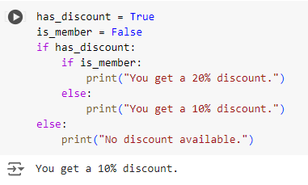
Nested If Statements
Examples
Nested Condition for Shopping
This code first checks if has_discount is True and then checks if is_member is also True. Since is_member is False, it prints "You get a 10% discount."

Slide 35
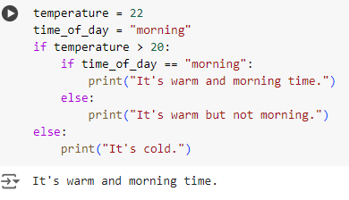
Nested If Statements
Examples
Nested Temperature and Time Check
This code checks if temperature is greater than 20 and then checks if it's morning. Since both conditions are true, it prints "It's warm and morning time."

Slide 36
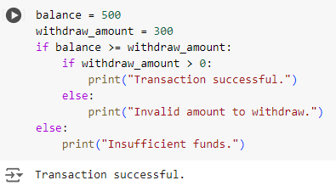
Nested If Statements
Examples
Bank Account Balance Check
This code checks if the balance is sufficient for the withdraw_amount and then checks if the amount is positive. Since both conditions are true, it prints "Transaction successful."

Slide 37
For Loops and While Loops

Slide 38
For Loops and While Loops
Loops are fundamental control flow structures in Python that allow you to execute a block of code multiple times. This session will cover the for loop and while loop, which are used for iterating over sequences and executing code as long as a condition is true, respectively. Understanding these loops is crucial for handling repetitive tasks efficiently in programming.

Slide 39
For Loops
A for loop is used to iterate over a sequence (such as a list, tuple, string, or range) and execute a block of code for each item in the sequence.

Slide 40
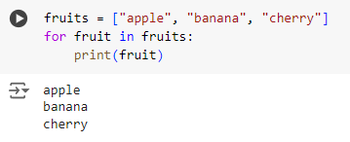
For Loops
Examples
Iterating Over a List
This loop iterates over each item in the fruits list and prints it.

Slide 41
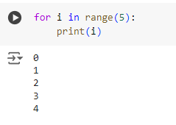
For Loops
Examples
Iterating Over a Range of Numbers
The range(5) function generates numbers from 0 to 4. The loop prints each number.

Slide 42
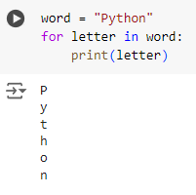
For Loops
Examples
Iterating Over a String
This loop goes through each character in the string "Python" and prints it one by one.

Slide 43
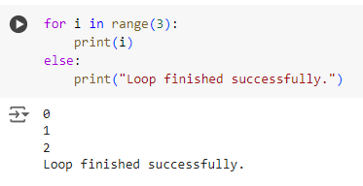
For Loops
Examples
Using a For Loop with an Else Clause
The loop prints numbers 0 to 2, and after the loop completes, the else clause executes

Slide 44
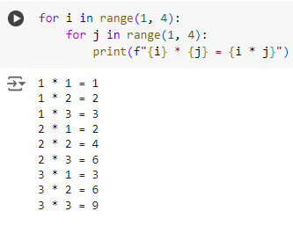
For Loops
Examples
Nested For Loop (Multiplication Table)
This nested loop generates a multiplication table for numbers 1 to 3.

Slide 45
While Loops
A while loop repeatedly executes a block of code as long as a specified condition remains true. It is often used when the number of iterations is not known beforehand.

Slide 46
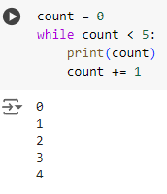
While Loops
Examples
Basic While Loop
This loop prints the value of count and increments it by 1 each time. It stops when count reaches 5.

Slide 47
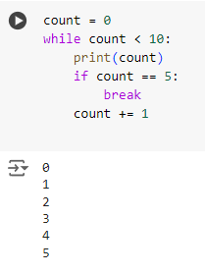
While Loops
Examples
While Loop with Break Statement
The loop prints numbers from 0 to 5. When count equals 5, the break statement stops the loop.

Slide 48
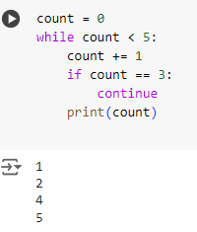
While Loops
Examples
While Loop with Continue Statement
This loop increments count by 1 in each iteration. When count is 3, continue skips printing and goes back to the loop.

Slide 49
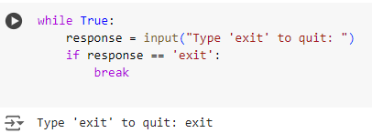
While Loops
Examples
Infinite While Loop with a Break
This loop runs indefinitely until the user types "exit". When "exit" is typed, the break statement ends the loop.

Slide 50
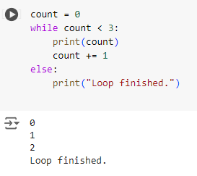
While Loops
Examples
While Loop with an Else Clause
The loop prints numbers from 0 to 2. When count reaches 3, the loop ends, and the else clause executes.

Slide 51
Summary
For Loops: Ideal for iterating over a known sequence, such as lists, strings, or ranges. They provide a straightforward way to execute a block of code multiple times.
While Loops: Useful when the number of iterations is not predetermined. They continue to execute as long as a condition remains true.
Break and Continue: break exits the loop immediately, while continue skips to the next iteration.
Else with Loops: Both for and while loops can have an else clause that executes when the loop completes naturally without hitting a break.

Slide 52
Practical Application

Slide 53
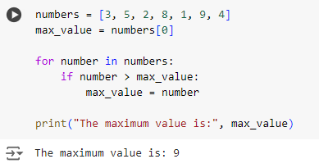
Finding the Maximum Value in a List
This for loop iterates over the numbers list to find the maximum value. It initializes max_value with the first element and updates it whenever it finds a larger number.

Slide 54
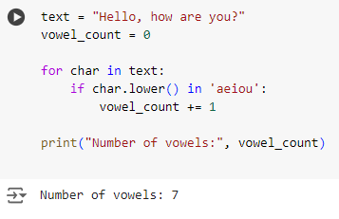
Counting Vowels in a String
This for loop goes through each character in the string text and checks if it is a vowel. It increments the vowel_count for each vowel found.

Slide 55
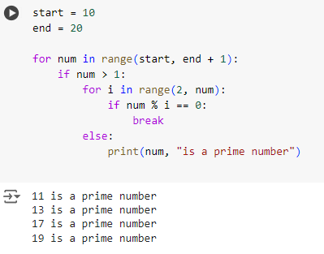
Finding Prime Numbers within a Range
The outer for loop iterates over numbers from start to end. The inner for loop checks if a number is divisible by any number other than 1 and itself. If it is, the break statement is executed, skipping to the next number.

Slide 56
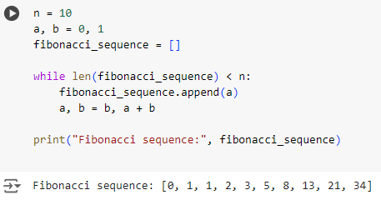
Generating a Fibonacci Sequence
This while loop generates a Fibonacci sequence of length n. It appends each new term to the fibonacci_sequence list until it reaches the desired length.

Slide 57
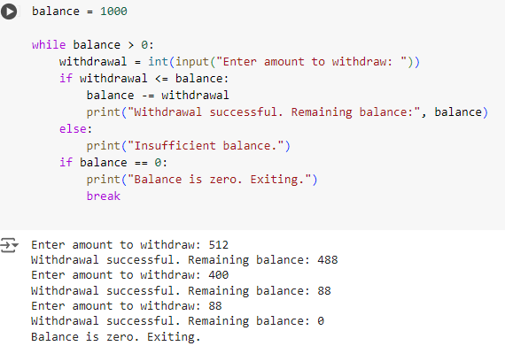
Simulating a Basic ATM Withdrawal
This while loop simulates an ATM withdrawal process. It checks if the withdrawal amount is less than or equal to the balance and updates the balance accordingly. If the balance reaches zero, it exits.

Slide 58
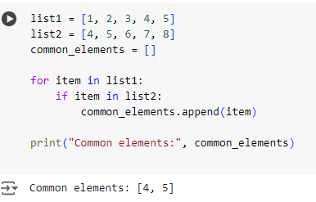
Finding Common Elements in Two Lists
This for loop checks each element in list1 to see if it exists in list2. If it does, the element is added to the common_elements list.

Slide 59
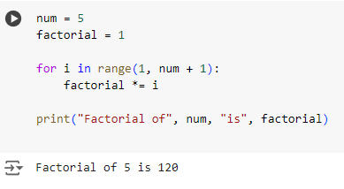
Calculating Factorial of a Number
This for loop calculates the factorial of a given number (num). It multiplies each integer from 1 to num to compute the factorial.

Slide 60
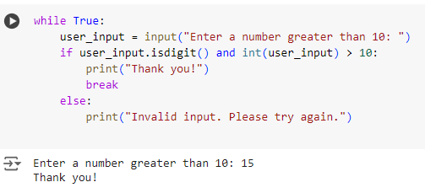
Validating User Input with While Loop
This while loop repeatedly asks the user for input until they enter a number greater than 10. The break statement exits the loop when valid input is provided.

Slide 61
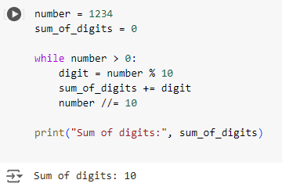
Finding the Sum of Digits of a Number
This while loop calculates the sum of the digits of a given number. It extracts each digit using the modulus operator and adds it to sum_of_digits.

Slide 62
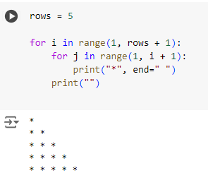
Drawing a Simple Pattern Using Loops
This nested for loop prints a simple right-angled triangle pattern using asterisks. The outer loop controls the number of rows, while the inner loop prints the stars.

Slide 63
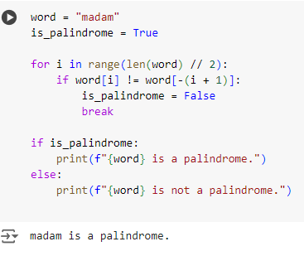
Checking for Palindrome Strings
This for loop checks if a string is a palindrome by comparing characters from the beginning and end moving towards the center. If any mismatch is found, it sets is_palindrome to False and breaks out of the loop.

Slide 64
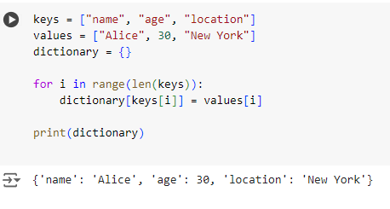
Creating a Dictionary from Two Lists
This for loop iterates over the indices of the keys list and creates a dictionary by associating each key with the corresponding value from the values list.

Slide 65
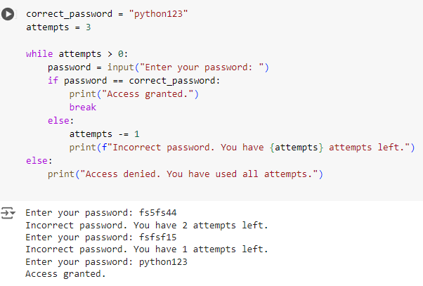
Simulating a Simple Password Check
This while loop simulates a password check, allowing the user up to three attempts to enter the correct password. If the correct password is entered, the loop breaks. Otherwise, it decrements the attempts and continues.

Slide 66
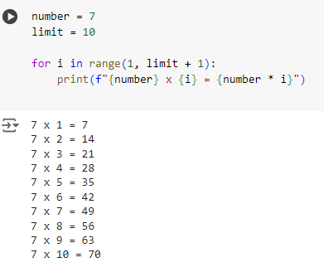
Generating a Multiplication Table for a Given Number
This for loop generates a multiplication table for the number (7 in this case) up to the specified limit (10). It multiplies the number by each value from 1 to limit and prints the result.

